Slide 1
01 / 08
Theme 01
Razorpay Buildathon
PROJECT TITLE
AEGIS — Autonomous Commerce Operating System
Sanjeev Kumar S sanjeevkumaredu8@gmail.com
ONE-LINE PITCH
AEGIS lets AI buyers grow and complete commerce autonomously—while every money action is explainable, cryptographically authorized, deterministically gated, and auditably executed.
Theme 01: AI Growth & Agentic Commerce

Slide 2
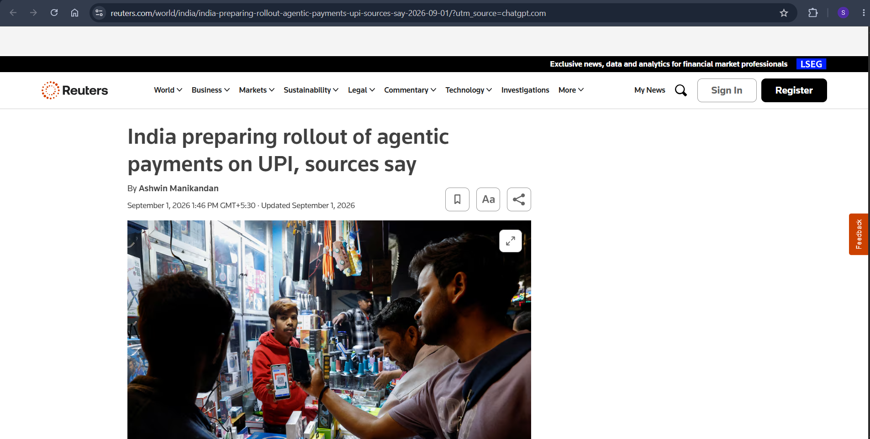
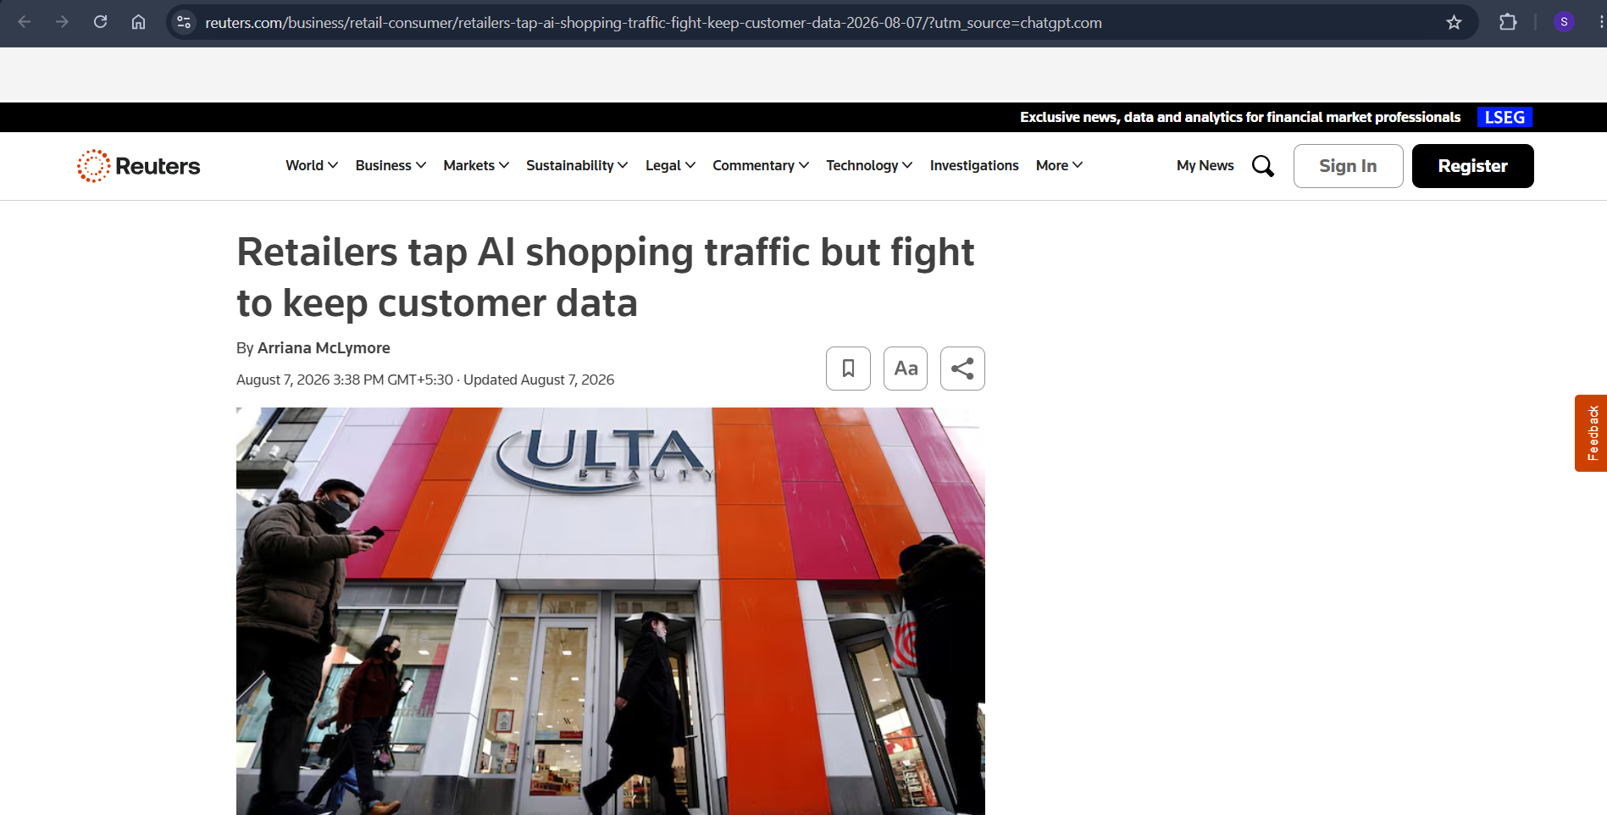
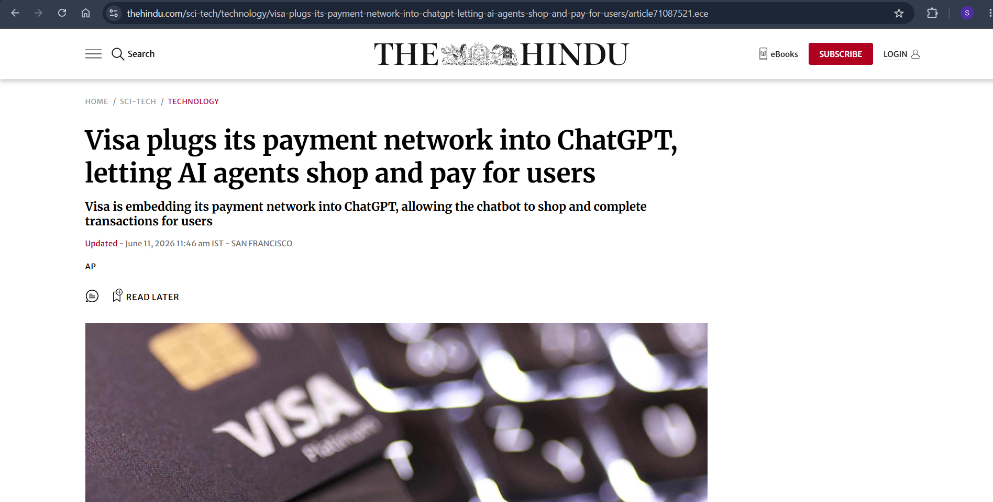
02 / 08
News article of problem faced
Problem Definition
AI Buyers Are Becoming Autonomous — Commerce Infrastructure Isn’t Ready
AI can discover and recommend products, but payment execution remains a high-risk boundary.
Traditional commerce systems assume humans make the final purchase decision.
Autonomous agents introduce new attack surfaces:
Prompt Injection
Amount Escalation
Merchant / Recipient Substitution
Category Manipulation
Intent & Parameter Tampering
Existing agentic workflows can create a dangerous gap between what the AI intended and what actually gets paid.
The Core Problem
How do we let AI buyers act autonomously without giving them unrestricted financial authority?
Missing Layer
AI Intelligence → Direct Payment Access
What’s needed:
AI Decision → Cryptographic Authorization → Deterministic Policy → Payment

Slide 3








03 / 08
Proposed Solution – AEGIS
AEGIS is a deterministic trust boundary for autonomous commerce agents, mediating every purchase action before it reaches payment infrastructure. It separates AI-driven discovery and decision-making from cryptographic authorization and policy enforcement. Every transaction is continuously validated, risk-checked, and recorded before execution.
AI-Readable Commerce Catalog — Structures merchant inventory so AI buyers can discover, understand, compare, and transact.
Conversational Agentic Checkout — Takes the journey from “Find me a product” → “Select” → “Authorize” → “Pay.”
Autonomous Product Discovery — Converts natural-language intent into relevant product candidates and identifies the best-fit offer.
Explainable Purchase Decisions — Every AI recommendation exposes its selection score and decision factors before money moves.
AI Growth & Ranking Engine — Optimizes product selection using intent, price, quality, availability, merchant trust, and fulfillment signals.
Bounded & Gated Transactions — Budget, merchant, category, and intent constraints are cryptographically bound and deterministically enforced.
Merchant AI Discoverability — Improves how products are represented for machine-mediated demand, making merchants more sellable to AI buyers.
Failure-Safe Payment + Audit Trail — Attack or policy violation → BLOCK / ₹0 MOVED, while successful transactions reach Razorpay Test Mode with a verifiable audit trail.

Slide 4
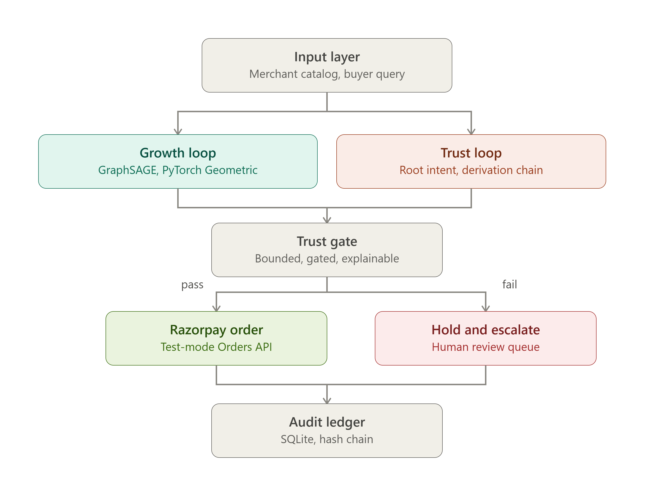
04 / 08
System Architecture

Slide 5
05 / 08
CLI Commands
# System
python backend/cli/main.py system status
# Agentic Commerce
python backend/cli/main.py agent run --intent "hotel in Goa under 3000"
# AI Growth Engine
python backend/cli/main.py growth predict --query "hotel in Goa under 3000"
# Security / Attack Lab
python backend/cli/main.py attack list
python backend/cli/main.py attack run amount-escalation
python backend/cli/main.py attack run poisoned-catalog
python backend/cli/main.py attack run recipient-substitution
python backend/cli/main.py attack run category-substitution
python backend/cli/main.py attack run derivation-tampering
python backend/cli/main.py attack run prompt-injection
# Audit / Evidence
python backend/cli/main.py ledger tail -n 5
python backend/cli/main.py ledger verify
python backend/cli/main.py ledger inspect <LEDGER_ENTRY_ID_OR_TX_ID>
# Tests
python -m pytest backend/tests/test_razorpay.py backend/tests/test_payment_gate.py -v
python -m pytest backend/tests/ -v

Slide 6
06 / 08
Common attacks:
Amount Escalation — Unauthorized increase in transaction value beyond the approved budget.
Poisoned Catalog — Manipulated product data attempts to influence the AI’s selection.
Recipient Substitution — Payment is redirected to an unapproved merchant or recipient.
Category Substitution — The approved product category is changed during execution.
Derivation Tampering — Authorized transaction parameters are altered after approval.
Prompt Injection — Malicious instructions attempt to override the user’s original purchase intent.

Slide 7
07 / 08
Operations/ Important Terms
1
SYSTEM ARCHITECTURE
2
INTENT NORMALIZATION
Probabilistic Commerce Plane — responsible for intent understanding, discovery and optimization.
Deterministic Trust Boundary — responsible for deciding whether that proposed transaction is actually authorized.
AEGIS converts this natural-language request into structured intent constraints:
category equals hotel, location equals Goa, and maximum budget equals ₹3,000.
3
AUTHORIZATION CHECKS
4
CORE PRINCIPLE
Is the amount within the authorized ceiling?
Is the merchant authorized?
Is the category within scope?
Is the derivation state valid?
AI proposes. Policy authorizes. Razorpay executes.

Slide 8
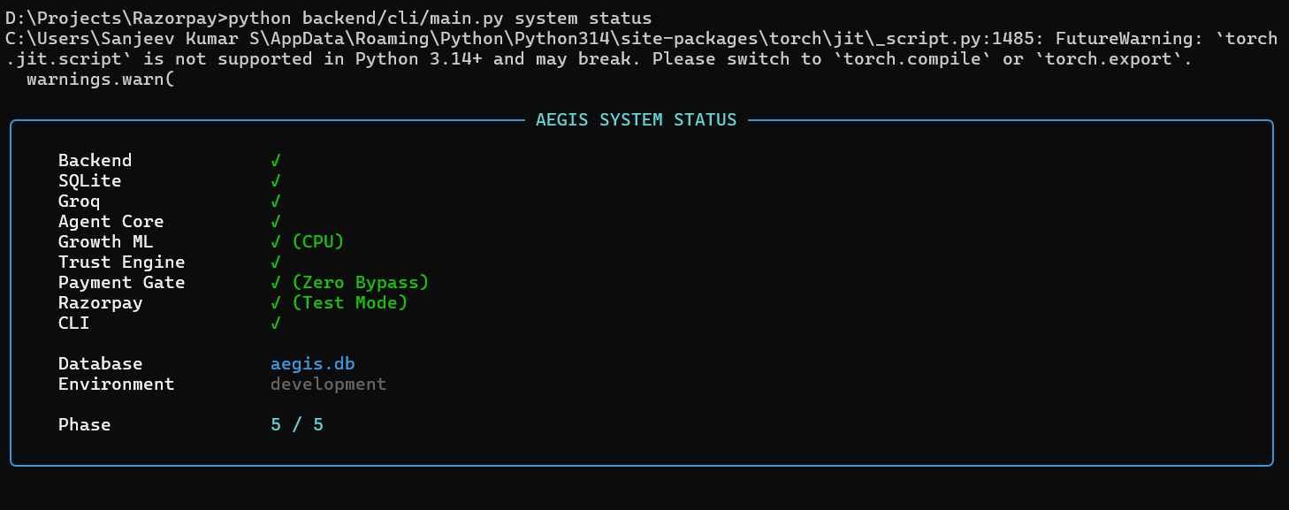
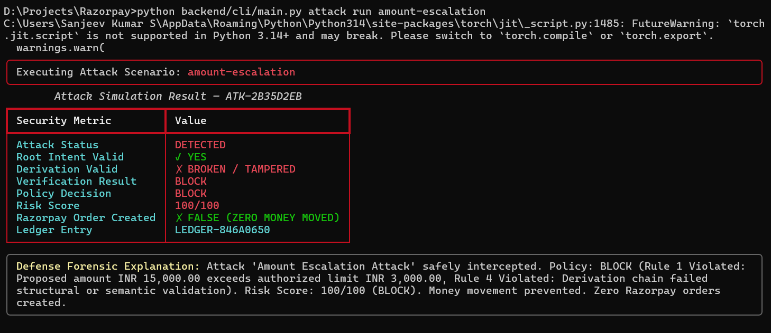
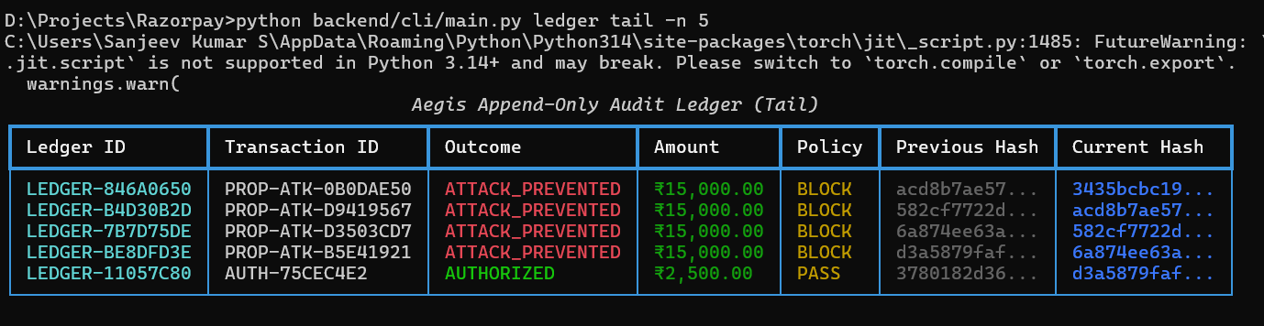
08 / 08
CLI Proofs

